Slide 1
Fundementals of Ecology General ecology
introductions
course overview
expectations
Martin Bulla bullam@fzp.czu.cz
Peter Mikula mikulap@fzp.czu.cz
Česká zemědělská univerzita v Praze • CZU Prague
Notes:
The aim of the lectures is not frontal teaching, but something that helps you.
Ask questions!!!

Slide 2


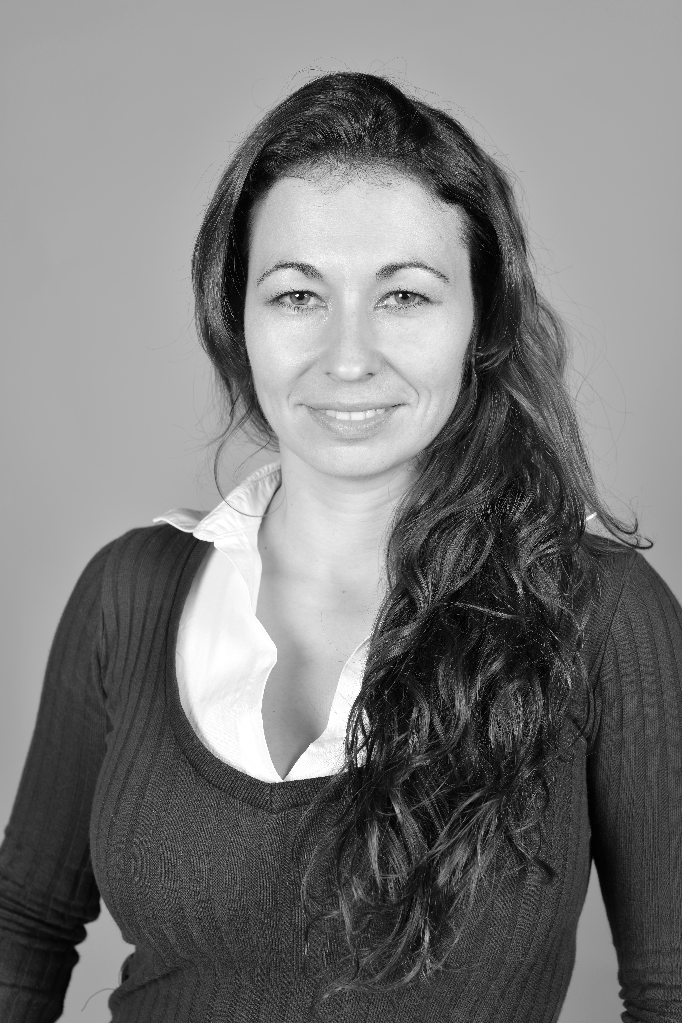

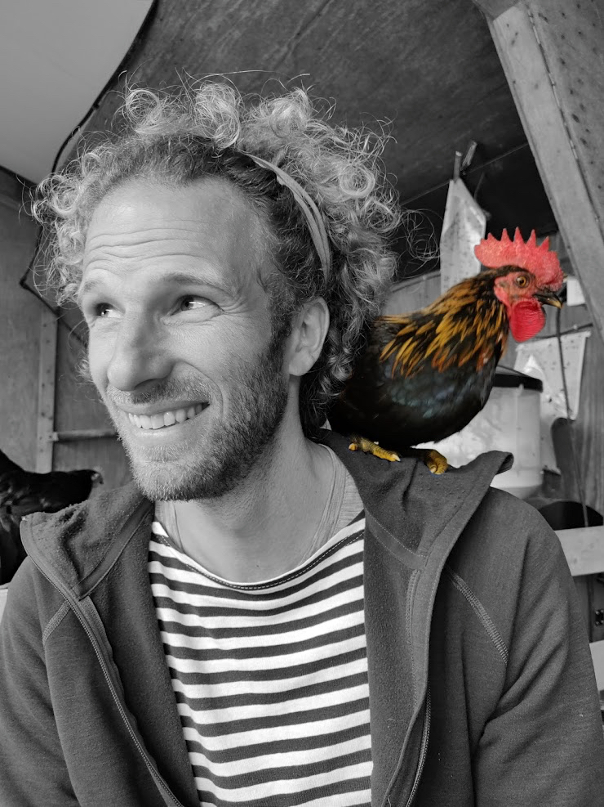
bullab
bullab.fzp.czu.cz
macroecology & evolution,
open science,
birds
, reproduction
, song
fear
reproducibility
biorhythms
Notes:
- a newly founded research group exploring global patterns and evolution of traits along with local adaptations
using mainly birds as our model species to understand reproduction and mating systems, song and fear;
all tied together by a common threads: biorhythms and reproducibility
- we are promoters of open science

Slide 3
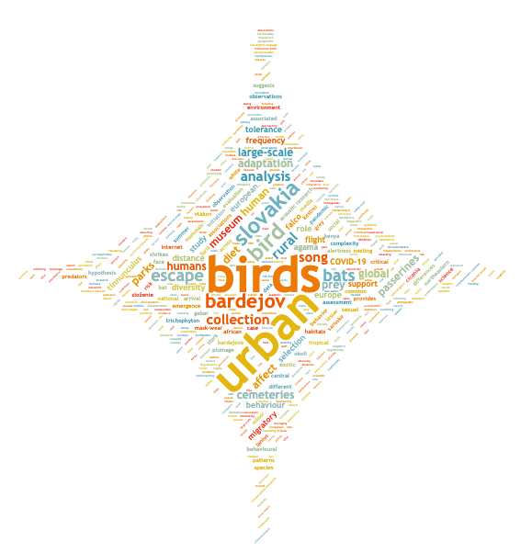
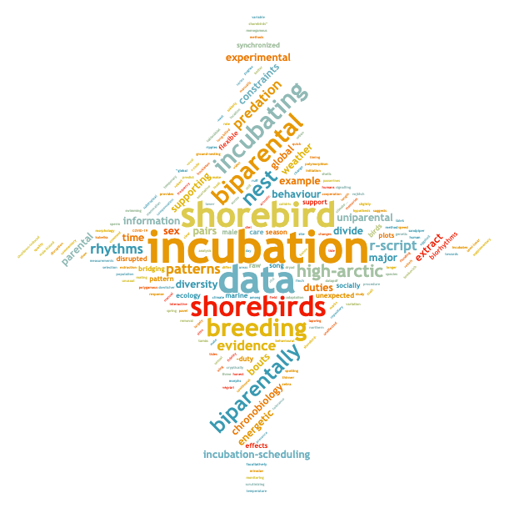
bullab
bullab.fzp.czu.cz
macroecology & evolution,
open science,
birds
, reproduction
, song
fear
reproducibility
biorhythms
https://scholargoggler.com

Slide 4










bullab
bullab.fzp.czu.cz
macroecology & evolution,
open science,
birds
, reproduction
, song
fear
reproducibility
biorhythms
Notes:
International team
Who is an Erasmus student?

Slide 5
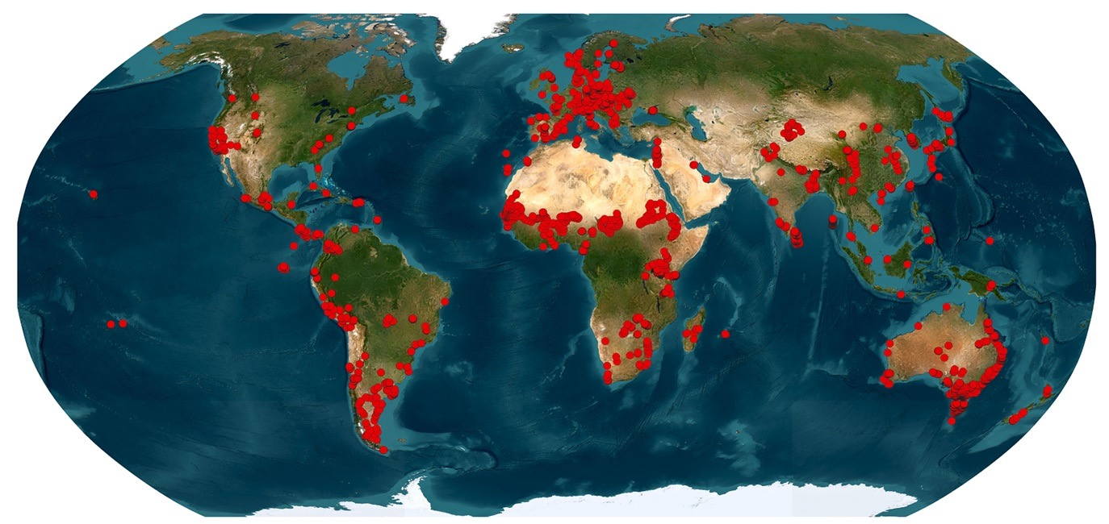
bullab
bullab.fzp.czu.cz
macroecology & evolution,
open science,
birds
, reproduction
, song
fear
reproducibility
biorhythms
Notes:
collaborate with institutions and people across the globe
quetions?

Slide 6

your turn
Notes:
Who are you?
One word wish for the course?

Slide 7
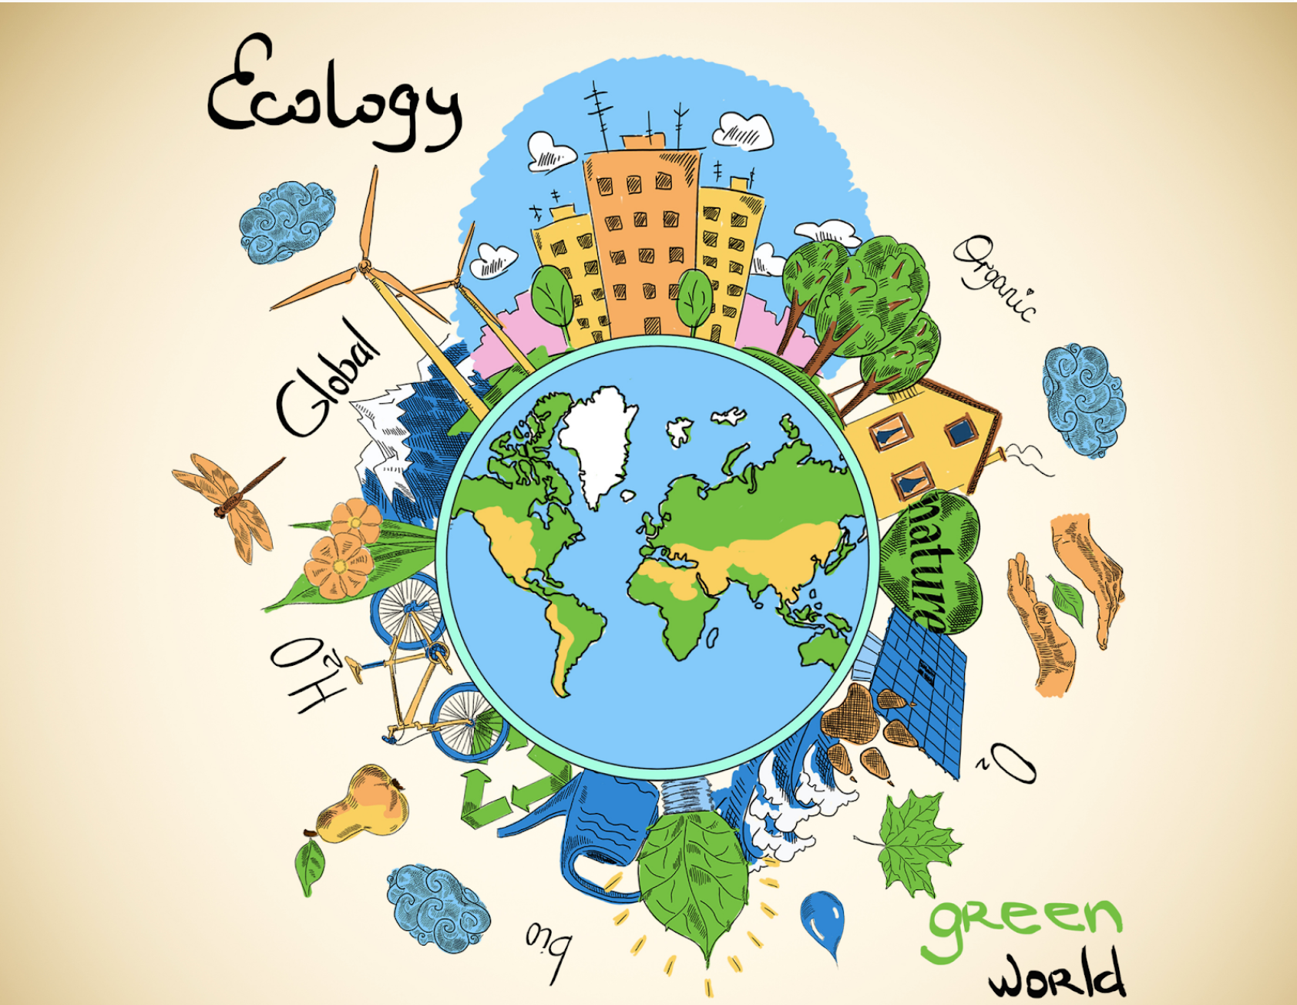
©Shelby Wells
Notes:
The aim of the course is to provide you with
a fundamental understanding of the science of ecology, its scope, methods, and
relevance to both basic and applied research.
Gain
insights into
ecological theory,
empirical approaches,
how ecology helps in addressing pressing global environmental challenges.
ability to work independently within a team (using individual strength to the team’s advantage)
experience in
synthetising literature
scientific communication
time management
critical thinking

Slide 8

©https://eej.ac.nz/
Notes:
Hands on learning
Work in team & Presentations = back bones of the course
Read and synthesize primary literature
Learn about basic ecological concepts
Practice scientific thinking and clear communication
Connect classic ideas with modern developments
Create re-usable study material for peers

Slide 9

Course format
21.10. 10:30 - 12:00 (Z118) Course intro
04.11. 10:30 - 12:00 (Z118) Intro to ecology
08.11. 10:30 - 12:00 (Z118) Intro to hands on
21.11. 8:30 - 17:00 Excursion
28.11. 8:30 - 17:00 (VN306) Home-work on the topics
05.12. 8:30 - 17:00 (VN306) Symposium (presentations)
Course material
https://github.com/MartinBulla/Ecology_Fund_Gen

Slide 10
Presentations logistics
15 min talk + 15 min discussion
On key aspects of ecology
Topic
Papers - traditional and current
10 teams of 4-5 people
randomly selected
all member contribute equally & present
work load
1 day – reading the papers and literature search
1 day – preparing the presentation
1 day – homework
1 day – presentation and engagement in the discussion
(your and presentations of others)

Slide 11
Presentations format
General
Short intro → main concepts → papers analysis → conclusions
Explain clearly
topic & key concepts
content of each slide & graphic
Compare classic vs. recent view
using the provided papers and your research
engage critically with methods, uncertainty, limitations, evidence
Acknowledge sources of information & visuals
Deep dive vs AI
List who did what on the final slide
Slides
Engaging
Keep text to minimum
Use high visual signal content (pics, photos, diagrams, graphs)
Number of slides vs detail vs thorough explanation
Study material for peers
Leave detailed descriptions for notes
Dynamic content welcomed, but
Export with notes as pdf
Notes:
Discuss what your learnt from your research vs from AI.
Engaging slides – rule of thumb: do the slides the way you learn the most when you see a presentation.
Study material – great if slides are dynamic (but either keep non-dynamic version or keep in mind that peers will study from the slides; text hidden behind boxes, pics non-suitable)
Various approaches
one has clear signal content per slide and then many slides are possible
other has dynamic (perhaps denser) slides, but then fewer slides are needed

Slide 12
Presentations evaluation
TEAM
Conceptual understanding and clarity (ability to synthesize primary literature)
Correctness: arguments grounded in evidence
Connection of classical ideas with modern developments
Engagement: ability to capture audience’s attention
Academic integrity
Structure: logical and easy to follow
Timing (15min)
Ability to discuss & defend your views
Reusability as study material for pears
Notes:
Presentation – a back bone of the course
Read and synthesize primary literature
Learn about basic ecological concepts
Practice scientific thinking and clear communication
Connect classic ideas with modern developments
Create re-usable study material for peers

Slide 13
Course requirements
Required for admission to the exam - active participation at
lectures
excursion
symposium
Passing the course requires grades 1, 2 or 3 from both:
(1 = 100-90%, 2 = 89-70%, 3 = 69-50%)
presentation (60%)
exam (40%)
Notes:
Active participation in the lectures, excursion and the symposium is required for the admission to the exam.
Passing the course requires grade 1-3 ( = 100-90%, 2 = 89-70%, 3 = 69-50%) from both components:
(1) Presentation (60%): clarity, scientific grounding, engagement, and defence of arguments during group presentation at the symposium.
(2) Exam (40%): written test evaluating knowledge of key ecological principles.
The final grade is the rounded weighted mean of the presentation and exam grades.

Slide 14
Topics & Readings
Eco-evolutionary dynamics & life histories
Population ecology essentials
Species interactions & coexistence
Food webs & network ecology
Macroecology & biogeography 1
Macroecology & biogeography 2
Global change ecology
Drivers of biodiversity crisis
Biodiversity (ecosystem functioning/services)
Applied ecology: New tools & data streams
Classic vs. modern papers
Notes:
PETO, can you create the list

Slide 15



Attandance
Fundamentals of Ecology
(ZEX101E)
Fundamentals of Ecology
(ZEX111E)
General Ecology
(ZEX12E)
Notes:
PETO, can you create the list

Slide 16
Topics & Readings
Eco-evolutionary dynamics & life histories
Population ecology essentials
Species interactions & coexistence
Food webs & network ecology
Macroecology & biogeography 1
Macroecology & biogeography 2
Global change ecology
Drivers of biodiversity crisis
Biodiversity (ecosystem functioning/services)
Applied ecology: New tools & data streams
Assignment to groups
Notes:
PETO, can you create the list

Slide 17
Eco-evolutionary dynamics & life histories
Does the fast-slow continuum adequately capture life history variation across taxa, or do we need multiple axes of life-history strategy?
Classic:
Stearns, S. C. (1977). The evolution of life history traits: a critique of the theory and a review of the data. Annual Review of Ecology and Systematics, 145–171.
Recent:
Stott, I. et al. (2024). Life histories are not just fast or slow. Trends in Ecology & Evolution, 39(9), 830–840.

Slide 18
Population ecology essentials
Allee effects: ecological curiosity or fundamental driver of population dynamics?
Classic:
Stephens, P. A., Sutherland, W. J., & Freckleton, R. P. (1999). What is the Allee effect? Oikos, 185–190.
Recent:
Muir, E. J., Lajeunesse, M. J., & Kramer, A. M. (2024). The magnitude of Allee effects varies across mechanisms. Oikos, 2024(7), e10386.

Slide 19
Species interactions & coexistence
Top-down control or bottom-up release: Is there evidence for predation’s grip on prey numbers?
Classic:
Krebs, C. J. et al. (1995). Impact of food and predation on the snowshoe hare cycle. Science, 269, 1112–1115.
Recent:
Krebs, C. J., Boonstra, R., & Boutin, S. (2018). Understanding the 10-year snowshoe hare cycle. Journal of Animal Ecology, 87, 87–100.

Slide 20
Food webs & network ecology
From keystone to rewiring: does food-web complexity build local biodiversity?
Classic:
Paine, R. T. (1966). Food web complexity and species diversity. The American Naturalist, 100(910), 65–75.
Recent:
Bartley, T. J. et al. (2019). Food web rewiring in a changing world. Nature Ecology & Evolution, 3, 345–354.

Slide 21
Macroecology & biogeography 1
Latitudinal gradients in biodiversity (and its dimensions) - how and why?
Classic:
Willig, M. R., Kaufman, D. M., & Stevens, R. D. (2003). Latitudinal gradients of biodiversity. AREES, 34, 273–309.
Recent:
Brodie, J. F., & Mannion, P. D. (2023). The hierarchy of factors predicting the LDG. TREE, 38(1), 15–23.

Slide 22
Macroecology and biogeography 2
How many species do we actually have on Earth? Why is it so hard to estimate?
Classic:
Mora, C. et al. (2011). How many species are there on Earth and in the ocean? PLoS Biology, 9(8), e1001127.
Recent:
Wiens, J. J. (2023). How many species are there on Earth? Progress and problems. PLoS Biology, 21(11), e3002388.

Slide 23
Global change ecology
Are we facing a sixth mass extinction?
Classic:
Ceballos, G. et al. (2015). Entering the sixth mass extinction. Science Advances, 1(5), e1400253.
Recent:
Wiens, J. J., & Saban, K. E. (2025). Questioning the sixth mass extinction. TREE, 40(4), 375–384.

Slide 24
Drivers of biodiversity crisis
What are the main drivers of the current biodiversity crisis?
Classic:
Bar-On, Y. M., Phillips, R., & Milo, R. (2018). The biomass distribution on Earth. PNAS, 115(25), 6506–6511.
Recent:
Jaureguiberry, P. et al. (2022). Direct drivers of global biodiversity loss. Science Advances, 8(45), eabm9982.

Slide 25
Biodiversity ↔ ecosystem functioning/services
From services to contributions: valuing nature in a human world
Classic:
Costanza, R. et al. (1997). The value of the world's ecosystem services and natural capital. Nature, 387, 253–260.
Recent:
Díaz, S. et al. (2018). Assessing nature's contributions to people. Science, 359(6373), 270–272.

Slide 26
Applied ecology: New tools & data streams
From new dawn to new standard: citizen science in ecology
Classic:
Silvertown, J. (2009). A new dawn for citizen science. TREE, 24(9), 467–471.
Recent:
Fraisl, D. et al. (2022). Citizen science in environmental & ecological sciences. Nature Reviews Methods Primers, 2, 64.

Slide 27
Fundementals of Ecology General ecology
introductions
course overview
expectations
Martin Bulla bullam@fzp.czu.cz
Peter Mikula mikulap@fzp.czu.cz
Česká zemědělská univerzita v Praze • CZU Prague

